Slide 1

ServiceNow Application
Files
Creation and Maintenance

Slide 2
Application Files
Configuration records that allow developers to extend application functionality
Application developers create application files when they add configuration records for application logic such as business rules, workflows, and script includes
The Application File [sys_metadata] table is the parent table for all tables that contain configuration records.
Notes:
Application files are configuration records that allow developers to extend application functionality.
Application developers create application files when they add configuration records for application logic such as business rules, workflows, and script includes.
The Application File or the sys_metadata table is the parent table for all tables that contain configuration records.
It provides a series of standard fields that define the attributes for a configuration record.
2

Slide 3
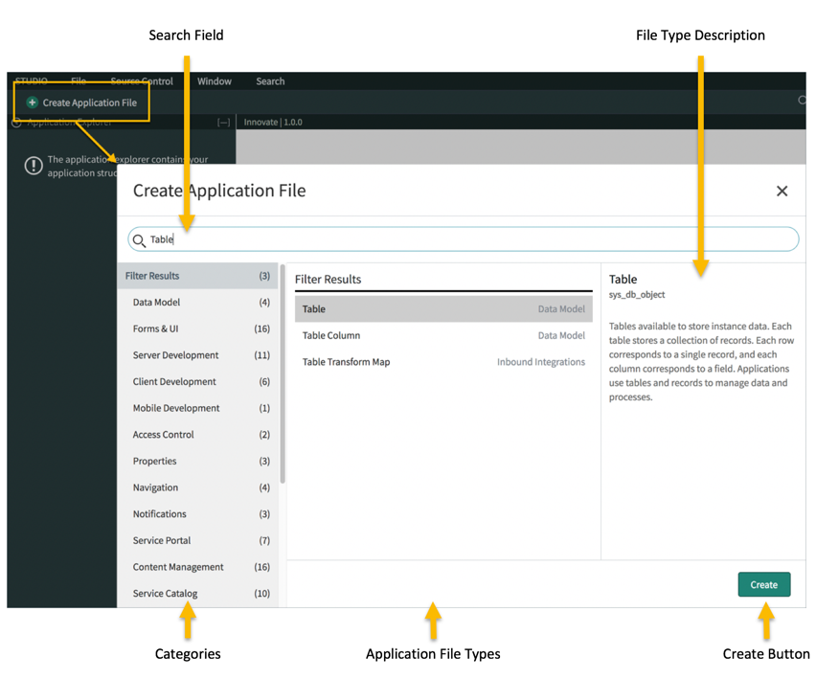
Application Files
Notes:
The procedure for adding files to an application is the same regardless of file type:
Click the Create Application File link.
Choose the new file type
and configure the new file.
To add an application artifact to an application, select the Create Application File button in Studio. The Create Application File dialog opens.

Slide 4
Application File Form
Field | Description
Display Name | Display name for the configuration record
Update Name | Unique identifier for the configuration record
Class | Table that contains the configuration record
Application | Application that contains the configuration record
Protection Policy | Policy that determines if the configuration record is protected from changes
Created | Creation date of the configuration record
Created By | User who created the configuration record
Updated | Last update date for the configuration record
Updated By | User who last updated the configuration record
Notes:
in creating application files, there are fields that need to be filled out and these are visible in the application file form
the display name is for the configuration record
Update Name is for the Unique identifier for the configuration record
Class, of which the Table that contains the configuration record
Application, Application that contains the configuration record
Protection Policy, that determines if the configuration record is protected from changes
and the rest are auto-filled.

Slide 5
Protection Policy
A read-only protection policy prevents anyone from modifying an application file or its related record.
To prevent customizations from being overwritten by system upgrades, the upgrade process automatically skips changes to customer-updated records.
If you modify an application file or related record that is later designated as Read-only in an upgrade, the application file maintains the default protection policy of Write.
Notes:
A read-only protection policy prevents anyone from modifying an application file or its related record.
To prevent customizations from being overwritten by system upgrades, the upgrade process automatically skips changes to customer-updated records.
If you modify an application file or related record that is later designated as Read-only in an upgrade, the application file maintains the default protection policy of Write.
Developer tip: Reverting a customized file to its baseline state causes the record to inherit the new protection policy as well. For example, a record going from a Write protection policy to a Read-only protection policy.
5

Slide 6
Exercise: Create the NeedIt Application from Source Control
In this section of the exercise, you will create a personal fork of the application repository to use with Developer Site learning content.
In a web browser, open github.com.
If you have a GitHub account, sign in. If not, sign up for a new account.
Once signed in, open the NeedIt repository.
Click the Fork button
On the Create a new fork page, deselect the Copy the main branch only option.
Select your personal GitHub account as the fork Owner, then click the Create fork button.
Verify the URL for your fork of the repository is similar to: <YourGitHubUsername>/devtraining-application-release.
Notes:
A read-only protection policy prevents anyone from modifying an application file or its related record.
To prevent customizations from being overwritten by system upgrades, the upgrade process automatically skips changes to customer-updated records.
If you modify an application file or related record that is later designated as Read-only in an upgrade, the application file maintains the default protection policy of Write.
Developer tip: Reverting a customized file to its baseline state causes the record to inherit the new protection policy as well. For example, a record going from a Write protection policy to a Read-only protection policy.
5

Slide 7
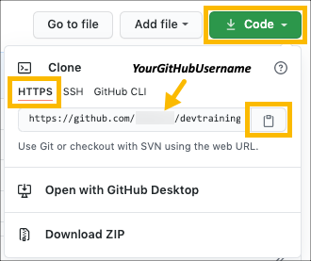
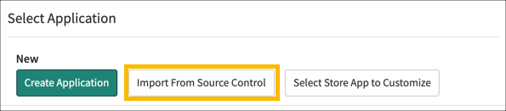
Exercise: Create the NeedIt Application from Source Control
Copy the forked repository's URL.
Click the Code button.
Make sure the URL contains your GitHub username, not ServiceNow.
Make sure HTTPS is selected. If not, select the HTTPS tab in the Clone flyout.
Click the Copy to clipboard button
Use the All menu to open System Applications > Studio.
Studio opens in a new browser tab.
In the Select Application dialog, click the Import From Source Control button.
Notes:
A read-only protection policy prevents anyone from modifying an application file or its related record.
To prevent customizations from being overwritten by system upgrades, the upgrade process automatically skips changes to customer-updated records.
If you modify an application file or related record that is later designated as Read-only in an upgrade, the application file maintains the default protection policy of Write.
Developer tip: Reverting a customized file to its baseline state causes the record to inherit the new protection policy as well. For example, a record going from a Write protection policy to a Read-only protection policy.
5

Slide 8
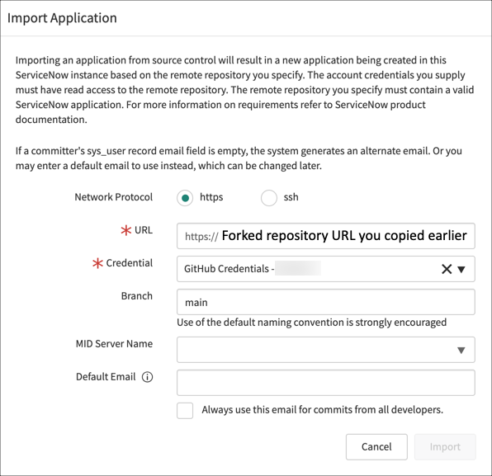
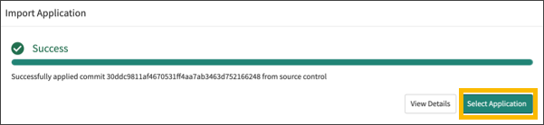
Exercise: Create the NeedIt Application from Source Control
8. In the Import Application dialog, configure the connection to the forked repository.
URL:<URL you copied for your forked version of the repository>
Credential:GitHub Credentials - <Your github.com Username>
Branch:main
9. Click the Import button.
10. When the application import is complete, click the Select Application button.
Notes:
A read-only protection policy prevents anyone from modifying an application file or its related record.
To prevent customizations from being overwritten by system upgrades, the upgrade process automatically skips changes to customer-updated records.
If you modify an application file or related record that is later designated as Read-only in an upgrade, the application file maintains the default protection policy of Write.
Developer tip: Reverting a customized file to its baseline state causes the record to inherit the new protection policy as well. For example, a record going from a Write protection policy to a Read-only protection policy.
5

Slide 9
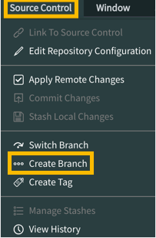
Exercise: Create a Branch for the Build the NeedIt Application
In this exercise, you will create a branch of the NeedIt application for the Build the NeedIt Application module that includes the application files used in the module.
If the NeedIt application is not open in Studio from the previous exercise, open it now.
In the main ServiceNow browser window, use the All menu to open System Applications > Studio.
In the Select Application dialog, click the NeedIt application.
In Studio, open the Source Control menu and select the Create Branch menu item.
Configure the branch.
Branch Name:CreateNeedItApp
Create from Tag:-- None --
Click the Create Branch button.
Click the Close button.
To load the application files included in the tag, return to the main ServiceNow browser tab (not Studio) and click the browser's reload button to refresh the page.
In this exercise, you created a branch. The main branch has no application files. You will add an application file in the next exercise.
Notes:
A read-only protection policy prevents anyone from modifying an application file or its related record.
To prevent customizations from being overwritten by system upgrades, the upgrade process automatically skips changes to customer-updated records.
If you modify an application file or related record that is later designated as Read-only in an upgrade, the application file maintains the default protection policy of Write.
Developer tip: Reverting a customized file to its baseline state causes the record to inherit the new protection policy as well. For example, a record going from a Write protection policy to a Read-only protection policy.
5

Slide 10
Exercise: Create the NeedIt Table
In this exercise, you will use Studio to add a table to the NeedIt application. The NeedIt table extends the Task table.
Create the NeedIt Table
1. If the NeedIt application is not open in Studio from the last exercise, open it now.
In the main ServiceNow browser window, use the All menu to open System Applications > Studio.
In the Select Application dialog, click the NeedIt application.
2. Add a table to the NeedIt application.
In Studio, click the Create Application File link.
In the Filter... field, enter the text Table OR select Data Model from the categories in the left hand pane.
Select Table in the middle pane as the file type, then click the Create button.
Configure the table:
Label:NeedIt
Name:(This field value is automatically created.)
Extends table:Task
Create module:Selected (checked)
Create mobile module:Selected (checked)
Add module to menu:-- Create new --
New menu name:NeedIt
Notes:
in

Slide 11
Exercise: Create the NeedIt Table
e. Switch to the Controls section (tab) and configure the controls:
Auto-number:Selected (checked)
Prefix:NI
Number:2000
Number of digits:6
Create access controls:(This field must be selected for scoped applications.)
User role:(This field value is automatically created. Notice the syntax of the user role name.)
3. Click the Submit button to save the table.
4. Examine the Application Explorer. Notice that creating a table created other application files: Roles,
Access Controls, Application Menus, Modules, Application Menus (Mobile), and Modules (Mobile).
5. On the NeedIt table record, switch to the Columns section (tab). Notice that although you did not
add columns to the table, the table has columns. The columns are inherited from the Task table.
6. Verify creation of the NeedIt application menu and module.
Return to the main ServiceNow browser window (Not Studio).
Use the browser's Reload button (browser dependent) to reload ServiceNow.
Open the All menu and type NeedIt in the Filter field. You should see the NeedIt menu and a NeedIts module.
Notes:
10

